Slide 1


Case Study 1: Complementing Visual Inspection with Technology Tools and Heuristics for Bridge Condition Evaluation and Asset Management
I-76 PENCOYD VIADUCT
Case Studies of Technology Leveraging to Address Bridge Performance Concerns

Slide 2
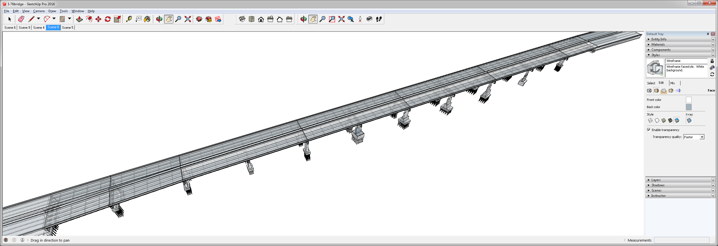

I-76 PENCOYD VIADUCT
Scenario: Many complaints from drivers regarding severe vibrations
Span 10
Span 8
Span 9
Span 6
Span 7
Span 4
Span 5
Span 2
Span 3
WESTBOUND
EASTBOUND
Span 1

Slide 3
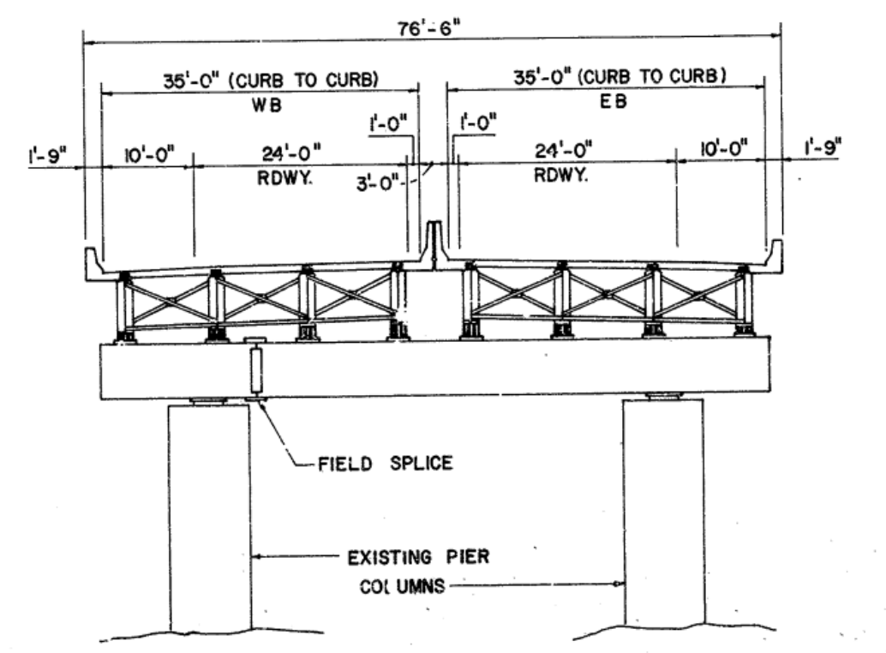
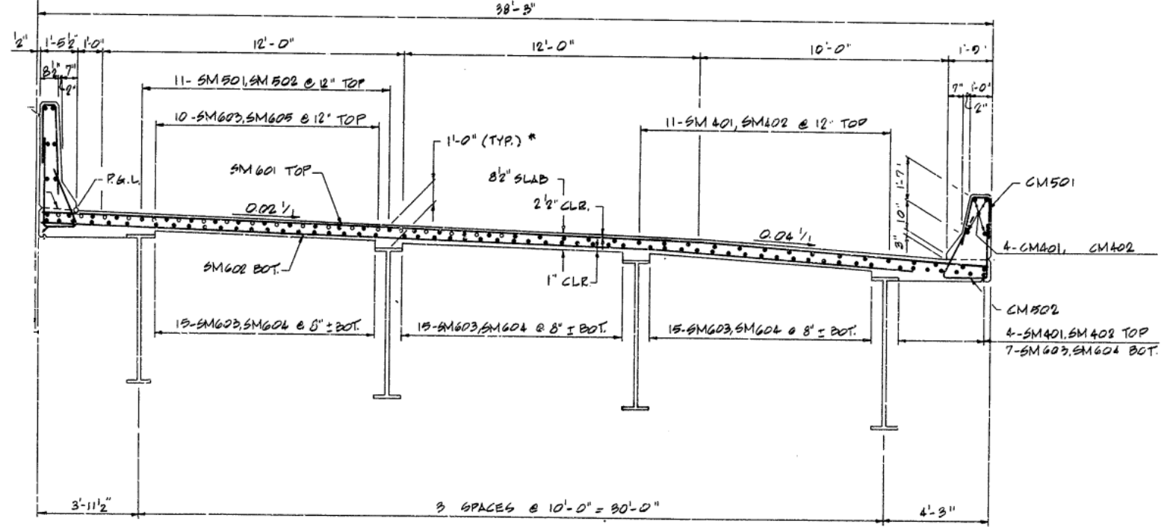
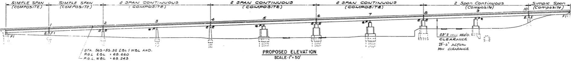
I-76 PENCOYD VIADUCT (1986)
Half section Span 7 and 8
Cross section
Elevation

Slide 4
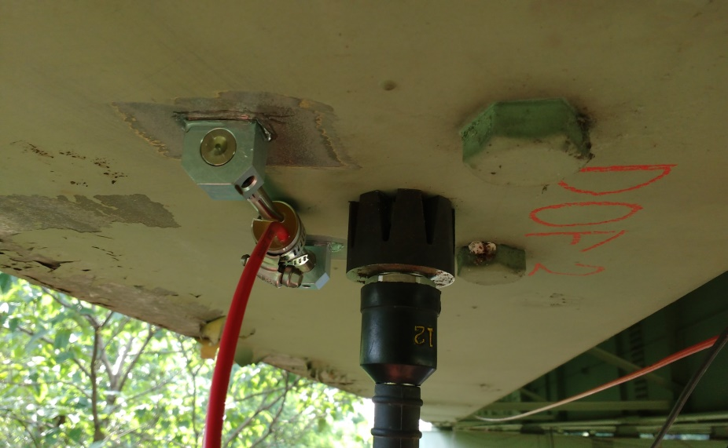
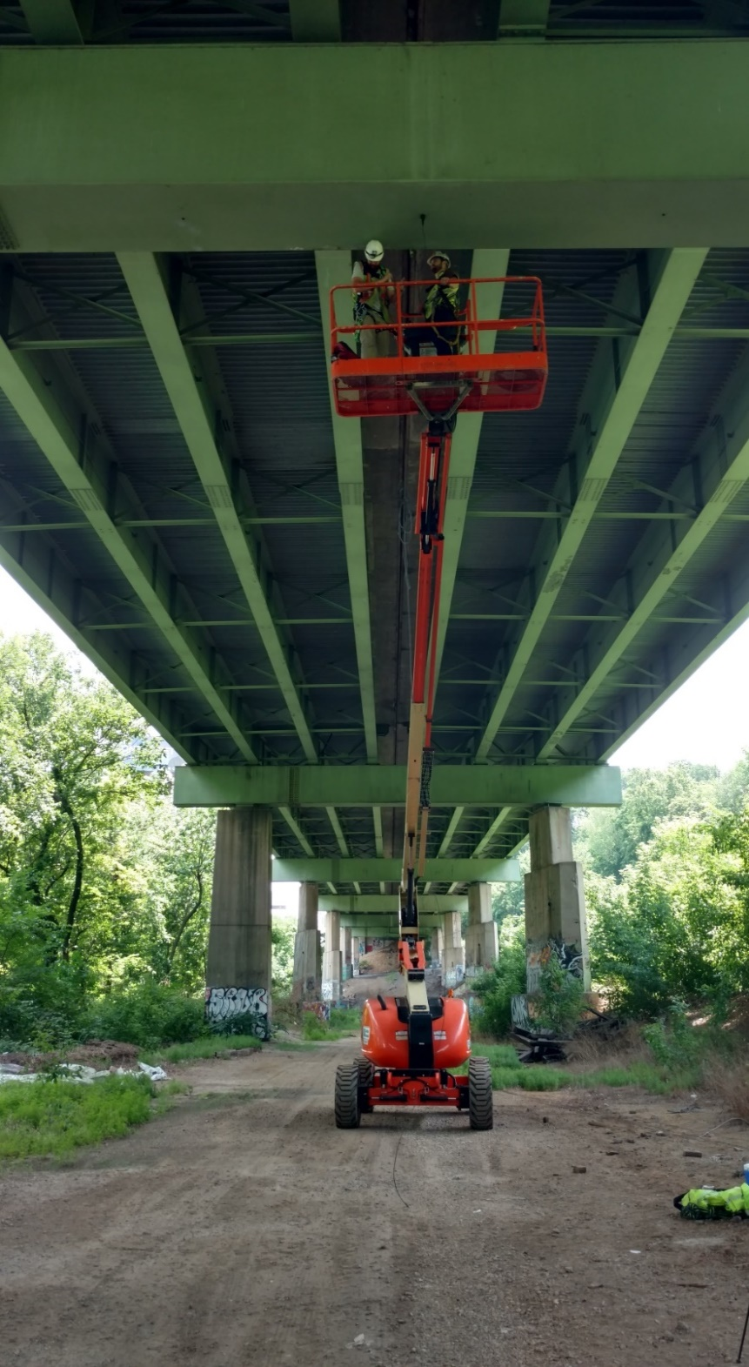
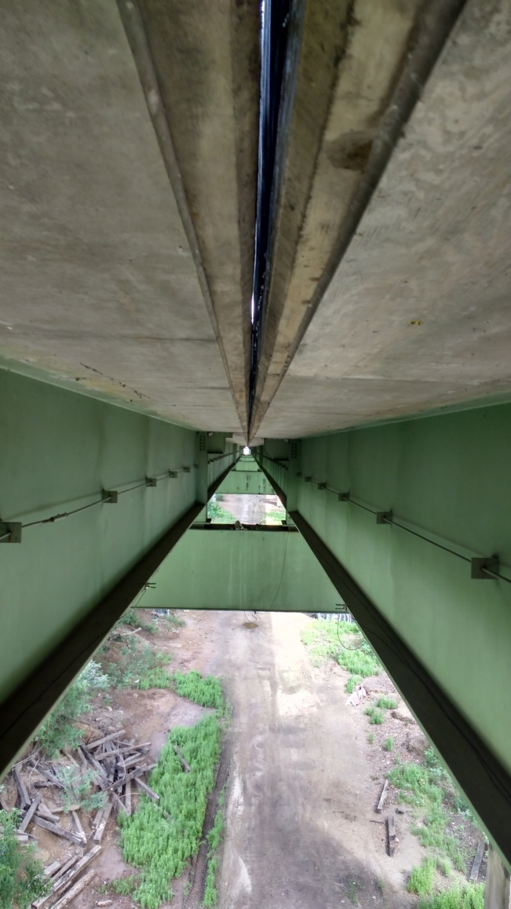
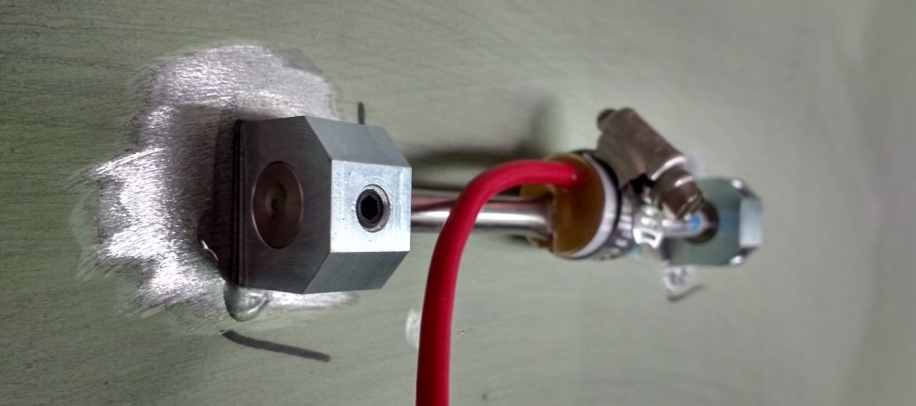
Case Study: I-76 Pencoyd Viaduct
First Test: Operational vibration and strain monitoring
INSTRUMENTATION PLAN
30 Accelerometers
12 Strain Gauges
24 hours of data collected

Slide 5
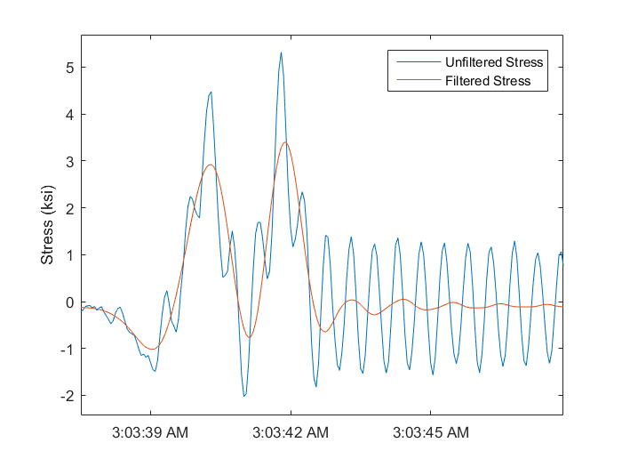
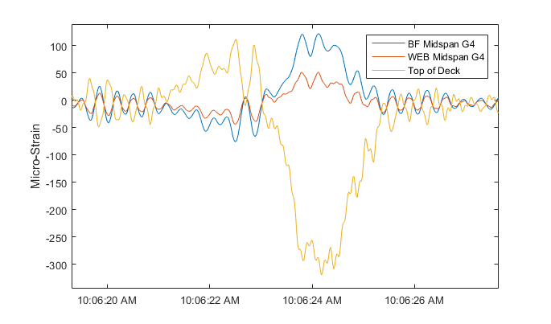
Case Study: I-76 Pencoyd Viaduct
Observations from Strain Data:
High operational stress indicated that the bridge experiences large deflections.
To isolate dynamic response and static response, a low pass filter was applied to the data. The filtered response approximates the static stress response. An apparent dynamic amplification factor of 50% is observed.
The response is cyclic which presents fatigue concerns.
Extrapolated tension in the deck (at mid-span) reaches fatigue cracking threshold.
50%
Concrete: 350 psi
Strain time histories at midspan

Slide 6
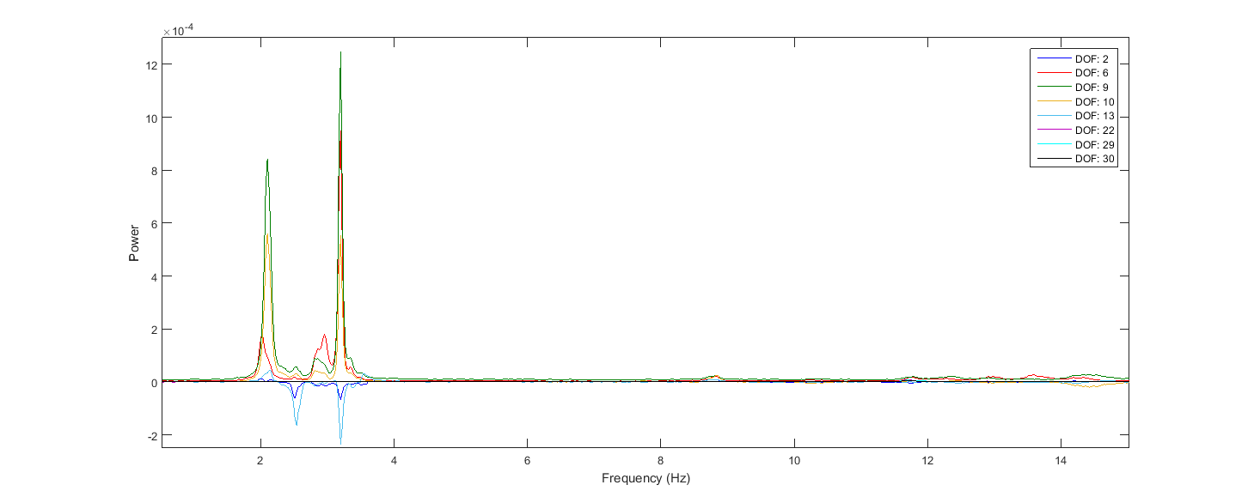
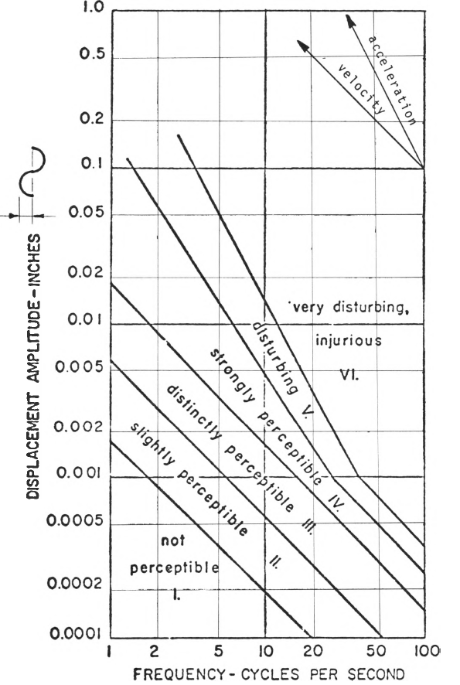
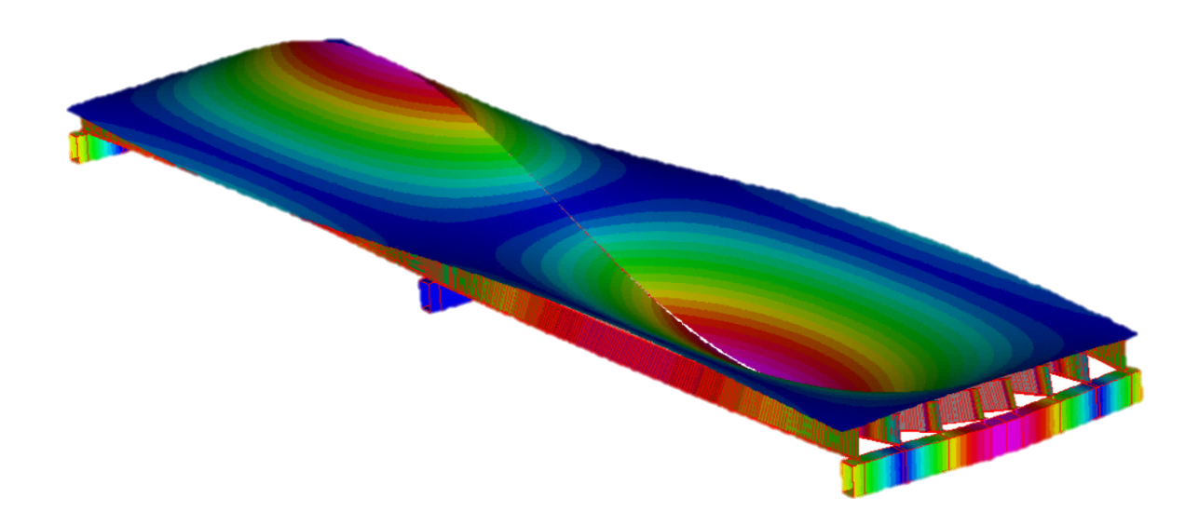
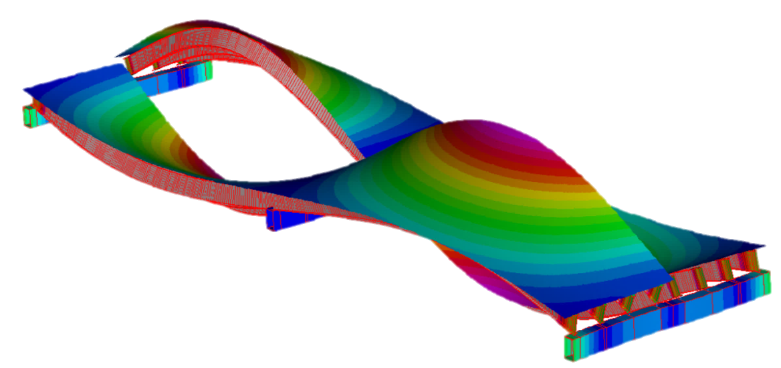
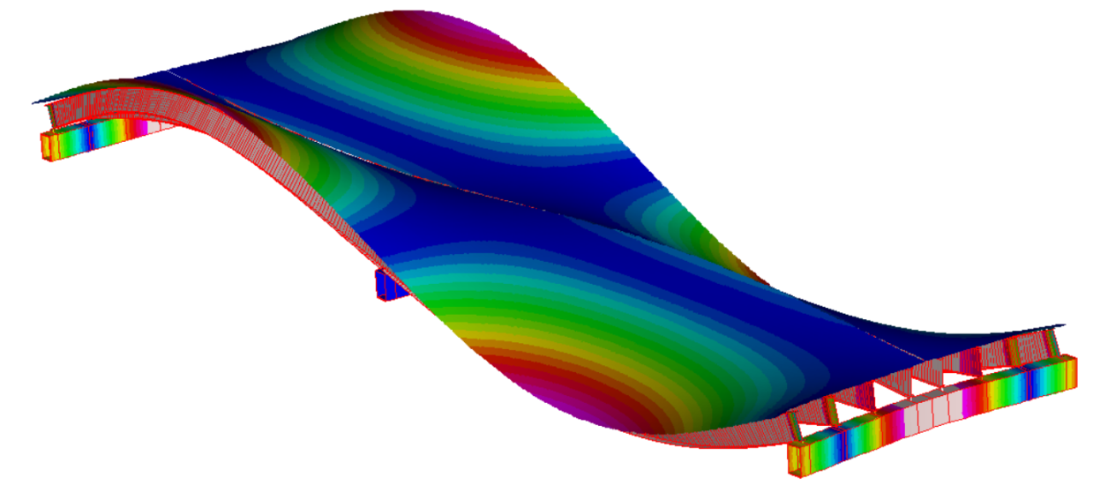
Case Study: I-76 Pencoyd Viaduct
Frequency content of acceleration time histories
Results from Acceleration Data:
Magnitude and frequency content of vibration are indeed beyond human comfort thresholds.
Accelerations of 25% g and near 2 Hz correspond to vibrational deflections of 0.5 in.
Mode shapes and frequencies were extracted from the data for model calibration.

Slide 7

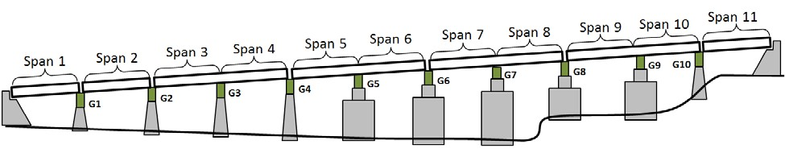
Case Study: I-76 Pencoyd Viaduct
Second Test: Vehicle-Bridge Interaction
Constraints:
Acquire data without impeding traffic.
Capture Truck and Bridge acceleration synchronously
Instrumentation Plan:
36 Accelerometers on Bridge
5 Accelerometers on Truck
2 Strain Gauges
3 Video Cameras
Instrumented Truck
Span 2
Span 3
Span 4
Span 7
Span 8

Slide 8
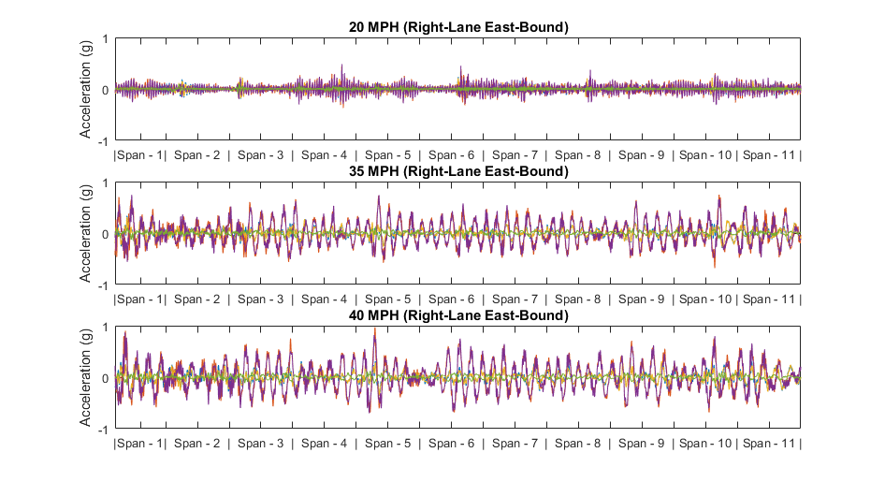
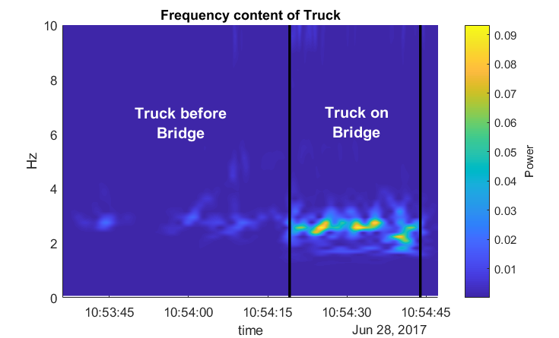
Case Study: I-76 Pencoyd Viaduct
Truck Acceleration Over Bridge at Different Speeds
Truck acceleration records show an increase in vibration with increased travel speed. Acceleration amplitudes of 0.5 g are frequently observed, corresponding to an applied force of 1.5X the truck’s static weight.
Wavelet Analysis of truck acceleration shows that truck vibration greatly increases when on the bridge and is excited in the 2-3 Hz range. Truck acceleration average amplitudes on the bridge are nearly twice those off the bridge.

Slide 9

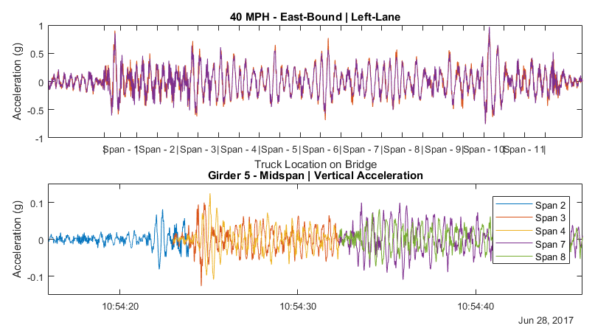
Case Study: I-76 Pencoyd Viaduct
The plots below are time synchronized and thus the time history in the top graph covers the exact same time as the bottom graph.
Notable features:
Large accelerations are induced in the truck as soon as it enters the bridge.
Truck acceleration repeatedly reaches levels in excess of 0.5g.
Apparent beating in the truck acceleration suggests the truck and bridge vibrations go in and out of phase.
Accelerations in excess of 0.1g are induced in the bridge spans by the single truck when it enters the respective span.
initial excitation
typ. peak amplitudes
apparent beating

Slide 10
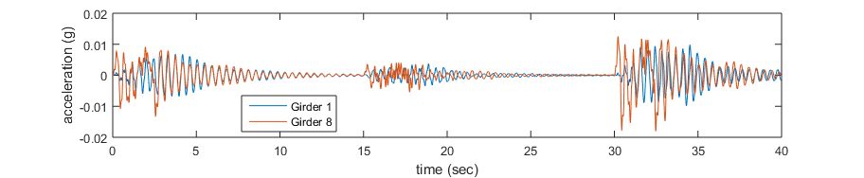
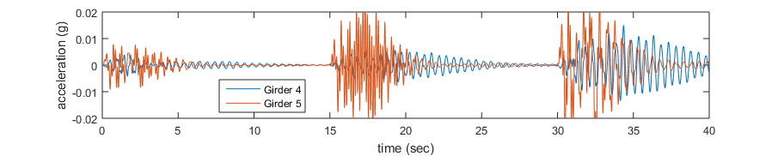
Case Study: I-76 Pencoyd Viaduct: FEM Simulation
Span 7
Non-Loaded Side
Loaded Side
Mid-span
The FE model was used to simulate trucks crossing on one side of the bridge through the use of a linear transient solver. The plots above show how much girders 1 and 4 are excited when loads are only applied on the span supported by girders 5 through 8.
An FFT performed on the simulated data shows that the modes that deform the cross-girder are those principally excited on the non-loaded side. Thus the cross girder is able to transmit vibrations from one side of the bridge to the other.

Slide 11
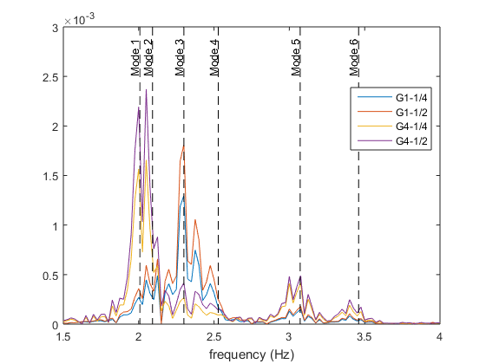
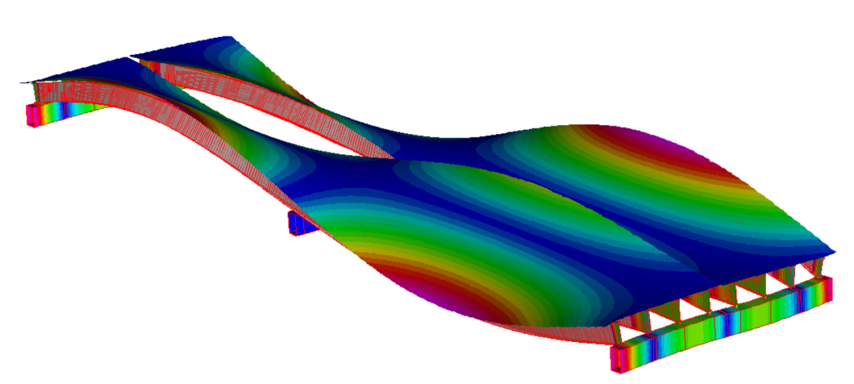
Case Study: I-76 Pencoyd Viaduct: FEM Simulation
Modes of Vibration Activated on Non-Loaded Side
Mode 1
Mode 2
Mode 3
Mode 4

Slide 12
Case Study: I-76 Pencoyd Viaduct: FEM Simulation
Preliminary Results
2-span continuous | Single 72kip pt. mass
Several simplified FE models were created to study traffic scenarios and the structure’s response. The case models were made such that they had stiffness, mass and dynamic properties similar to the Viaduct. The following models were created:
Two consecutive simple spans
Two-span continuous
Multiple consecutive simple spans (8 spans)
Multiple two-span continuous (8 spans)
2-span continuous | Randomly spaced (6) 72kip pt. masses
The models were subjected to a variety of loading conditions, ranging from a single moving mass to multiple lanes of 100 vehicles with random spacing and different suspensions, damping and weights.
Preliminary results indicate that the initial conditions of the bridge (i.e. vibration induced by previous vehicles) has a significant impact on dynamic amplification.

Slide 13

Case Study: I-76 Pencoyd Viaduct: Interim Conclusions & Future Work
Thus far we have established that the bridge is indeed experiencing vibration in excess of human comfort limits and even causing stress levels in the deck that may contribute to fatigue cracking.
Simulation efforts have revealed that the cross-girder is capable of transmitting significant vibration from one side of the structure to the other. This would result in motorists sitting in traffic on one side of the bridge to feel disturbing vibrations caused by free flowing traffic in the other direction.
With the latest test efforts we have been able to capture the acceleration of a passing truck and the bridge synchronously, thus providing a record of vehicle-bridge interaction.
Through further simulations, we will attempt to replicate features of this vehicle-bridge acceleration record by adjusting structural and vehicle parameters. Furthermore, we can develop a forcing function from the recorded truck acceleration data which can be applied directly to the FE model.
Once the vibration characteristics of the bridge can be reliably replicated in the simulation models, we may begin to study which parameters most contribute to the large vibrations, and the structural attributes that could be altered to reduce the vibrations to acceptable levels.

